Slide 1
FL : Server
Vimalkumar Kumaresan Ph.D

Slide 3
Components
Agents
Aggregator
Database

Slide 4
Aggregator
Server
Communication
Agent Coordination
Global Model Initialization for new agents.
Receives Local Model from agents.
Cluster Model Synthesis
State Manager
Buffer Management (Both Local & Cluster Model before synthesis)
Check Function (Criteria)
Aggregator
Federated Averaging (FedAvg)

Slide 5
Database
Pseudo Database
Handshake Messages
ML Models
SQLite
CRUD Operations

Slide 6
Setup: Configuration
config_db.json
db_ip: An DB IP address
e.g. localhost
db_socket: A socket number used between DB and an aggregator.
e.g. 9017
db_name: Name of the SQLite database.
e.g. sample_data
db_data_path: Path to the SQLite database.
e.g. ./db
db_model_path: Path to the directory to save all ML models
e.g. ./db/models

Slide 7
config_aggregator.json
aggr_ip: An aggregator IP address
e.g. localhost
db_ip: An DB IP address
e.g. localhost
reg_socket: A socket number used by agents to join an aggregator for the first time.
e.g. 8765
exch_socket: A socket number used to upload local models to an aggregator from an agent. Agents will get to know this socket from the communications with an aggregator.
e.g. 7890
recv_socket: A socket number used to send back semi global models to an agent from an aggregator. Agents will get to know this socket from the communications with an aggregator.
e.g. 4321
db_socket: A socket number used between DB and an aggregator.
e.g. 9017
round_interval: Period of time after which an agent check if there are enough number of models to start an aggregation step. (Unit: seconds)
e.g. 5
aggregation_threshold: Percentage of the number of collected local models required to start an aggregation step
e.g. 1.0, 0.8
polling: A flag for using a polling method or not. If 1, use the polling method, otherwise use a push method.
e.g. 1

Slide 8
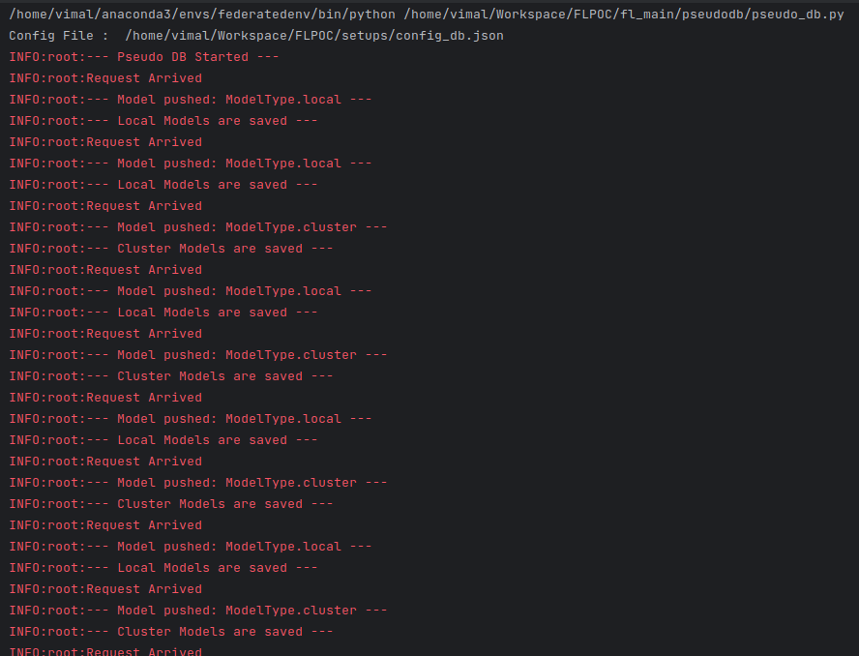
Pseudo DB

Slide 9
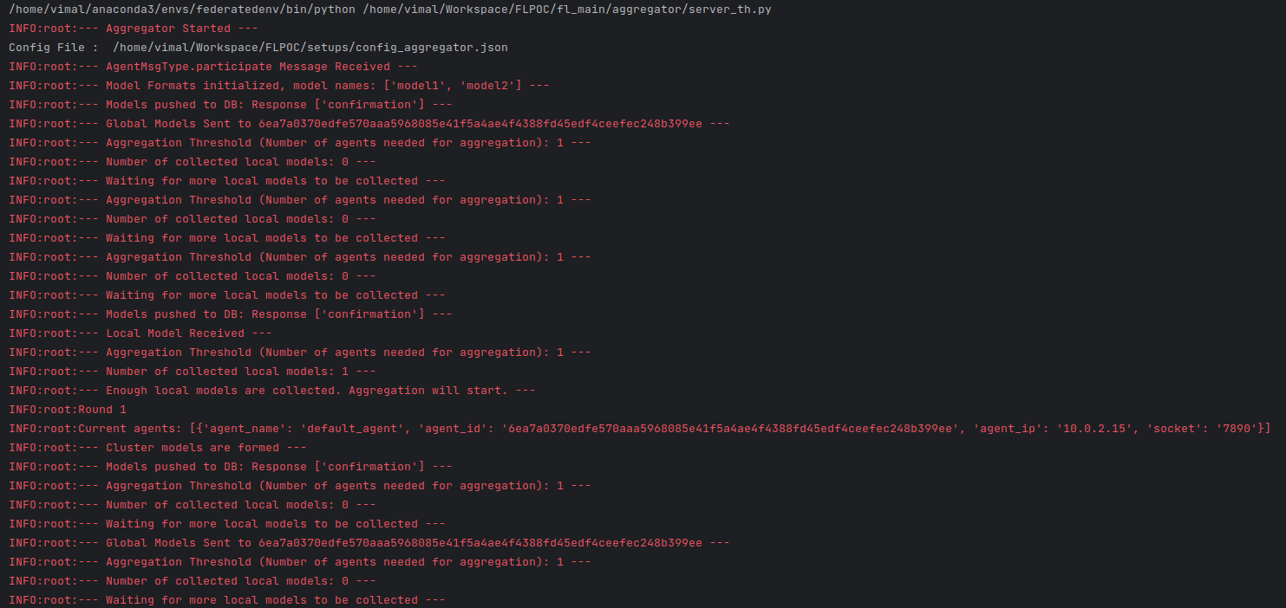
Server: Aggregator

Slide 10
Potential enhancements to the FL server
Redesigning the database
Automating the registry of an initial model
Performance metrics for local and global models
Fine-tuned aggregation

